Slide 1
Boosting Algorithm-Regression
Boosting Algorithm has 3 Types:
1) Ada Boost Algorithm 2)XG Boost Algorithm
3)LG Boost Algorithm

Slide 2
What is AdaBoost?
AdaBoost = Adaptive Boosting.
Adjusts weights of training examples to focus on hard-to-predict instances.
Final prediction: weighted sum (classification or regression)
Ada Boost Algorithm also Known as Adaptive Boost Algorithm.
Ada Boosting is a popular ensemble learning technique.
It combines multiple weak learners to create a strong predictive model.
Syntax:
class sklearn.ensemble.AdaBoostRegressor(estimator
=None,*,n_estimators=50,learning_rate=1.0,loss=‘linear’,random_state= None, base_estimator=‘deprecated’)

Slide 3
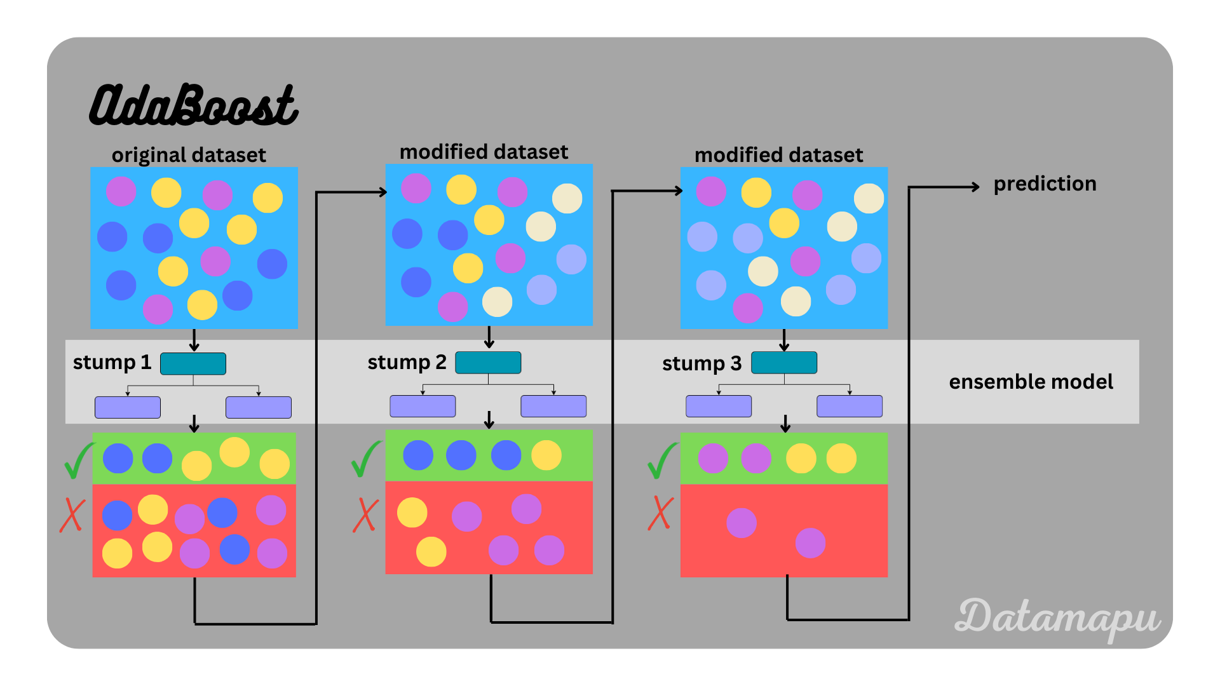
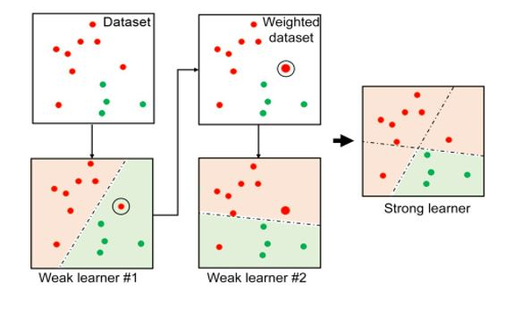
Ada Boost Algorithm

Slide 4
Parameters
Estimator →object, default=None.
The base estimator from which the boosted ensemble is built.
n_estimators→ int, default=50.
The maximum number of estimators at which boosting is terminated. In case of perfect fit, the learning procedure is stopped early.
learning_rate →float, default=1.0
Weight applied to each regressor at each boosting iteration. A higher learning rate increases the contribution of each regressor. There is a trade-off between the learning_rate and n_estimators parameters.
loss→{‘linear’, ‘square’, ‘exponential’}, default=’linear’
The loss function to use when updating the weights after each boosting iteration.

Slide 5
random_state→int, RandomState instance or None, default=None
Controls the random seed given at each estimator at each boosting iteration. Thus, it is only used when estimator exposes a random_state. In addition, it controls the bootstrap of the weights used to train the estimator at each boosting iteration.
base_estimator→object, default=Non
The base estimator from which the boosted ensemble is built.

Slide 6
AdaBoost in Python (Example)
from sklearn.ensemble import AdaBoostRegressor
from sklearn.tree import DecisionTreeRegressor
model = AdaBoostRegressor(
base_estimator=DecisionTreeRegressor(max_depth=4),
n_estimators=50,
learning_rate=1.0)
model.fit(X_train, y_train)

